Slide 1
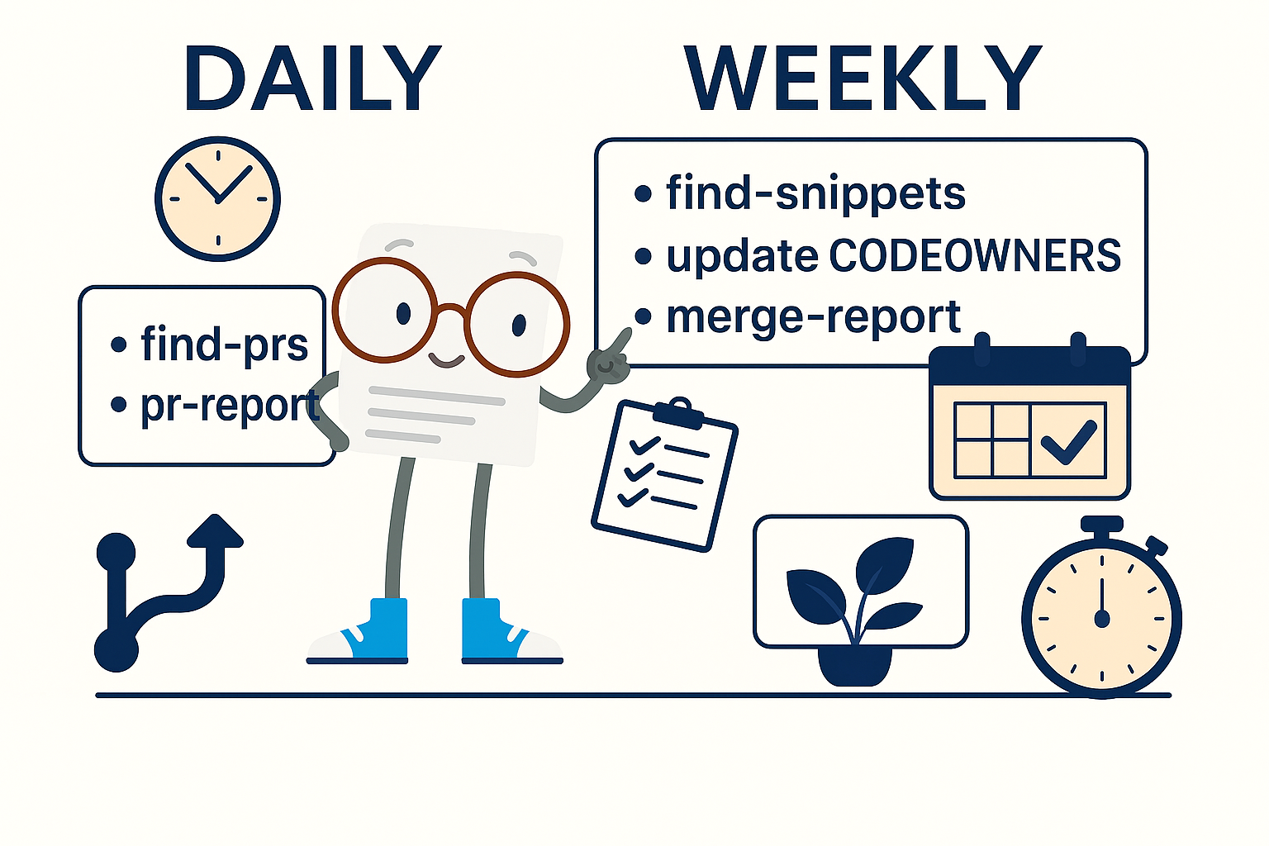
Code Snippet Maintenance in Documentation
Machine Learning Studio
Azure AI Foundry
Notes:
Welcome. This short video introduces the workflow for code maintenance in documentation, specifically what we do for Azure Machine Learning and Azure AI Foundry.

Slide 2
Definitions
Code Repo - Public GitHub repositories where sample code is stored
(foundry-samples)
Docs Repo - The MicrosoftDocs repository where documentation articles are stored
(azure-ai-docs)
Maintenance repo – GitHub repository where the code maintenance process scripts are stored
(sdgilley/code-maintenance)
Notes:
First a few definitions. There are three different types of repositories involved in this process. To try to keep them straight, we’ll call them te Code repo (where the sample code is stored), the Docs repo (where the markdown articles are stored), and the Maintenance repo (where the scripts for the maintenance workflow are stored).

Slide 3
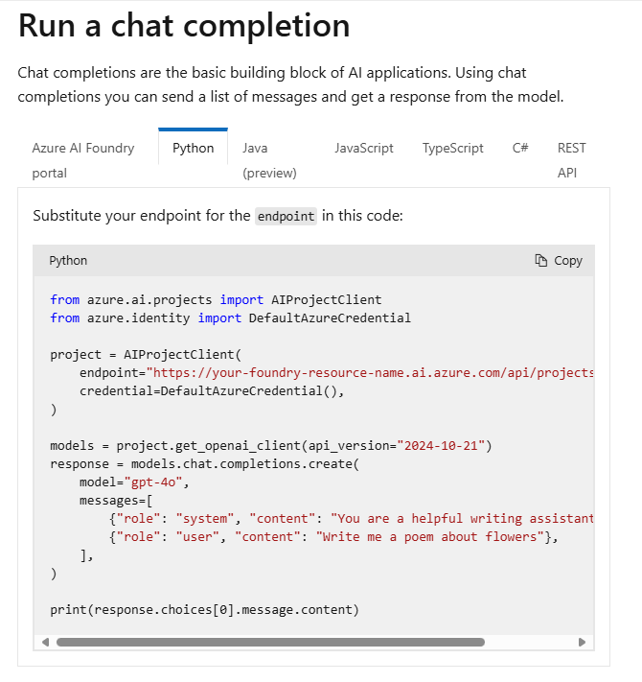
Learn site
Notes:
Now a quick overview of what we’re doing.
Here’s an example article on the learn site, which contains some code.

Slide 4
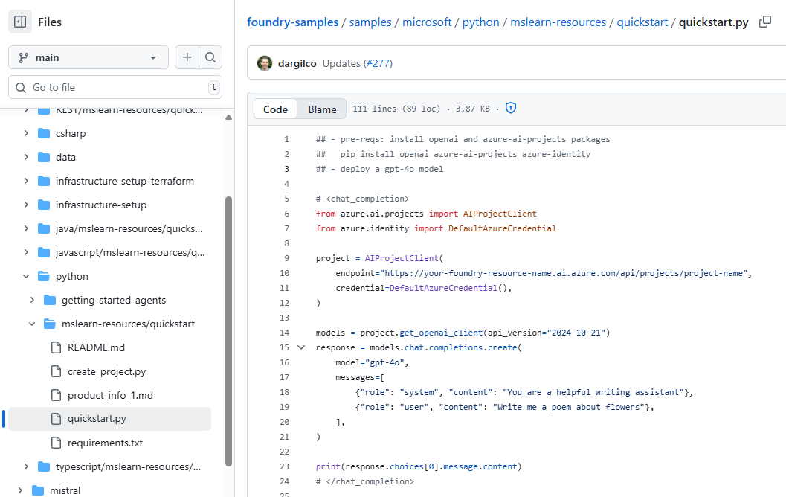
GitHub
# <chat_completion>
# </chat_completion>
Notes:
Here’s the actual code content, stored in a Code Repo. Note the comments that start and stop the block of code called chat_completion.

Slide 5
How to reference
azure-ai-docs:
.openpublishing.publish.config.json: { "path_to_root": "foundry-samples-main",
"url": "https://github.com/azure-ai-foundry/foundry-samples",
"branch": "main",
"branch_mapping": {}
},
Notes:
In order to use code from a external Code Repo, first you need to set a path_to_root entry in the config file. I always use the repo name, followed by -<branch name>.

Slide 6
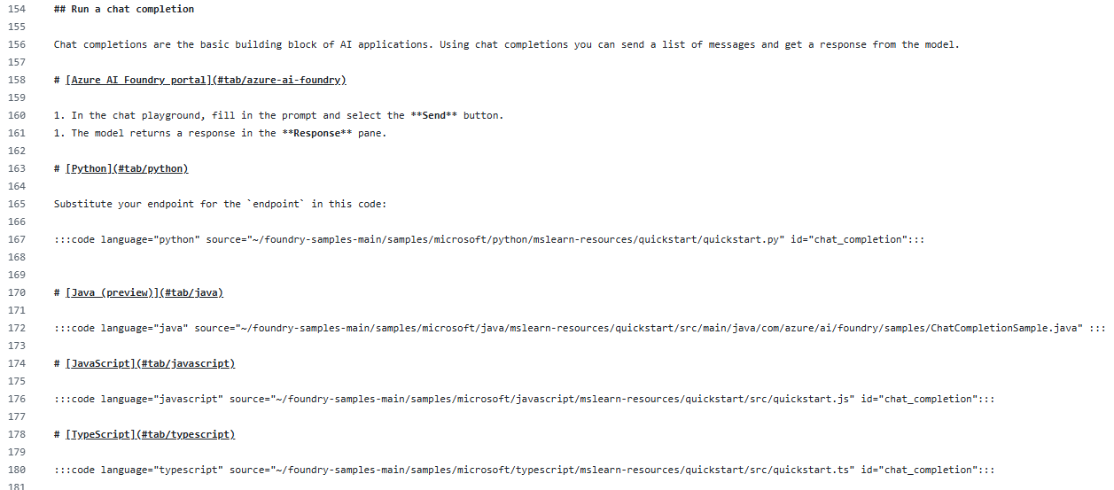
Article markdown
:::code language="python" source="~/foundry-samples-main/samples/microsoft/python/mslearn-resources/quickstart/quickstart.py" id="chat_completion":::
Notes:
Now that you have a path_to_root, use it to reference the file. Use id to get to the particular block you want to display.

Slide 7
Advantages
Code authored in a code editor
Code styles enforced by PR process in the code repo
Code repo maintained by teams using the code
Public GH repo and docs have single source of truth
Code repo can be set up with automated testing
Code is runnable
Notes:
What are the advantages of this approach? There are quite a few.
The code is authored in an editor that can show typos or mistakes.
It’s runnable.
When checking it in to the Code Repo, consistent styling can be enforced.
In our case, the code repo is maintained by teams that are using the code.
The Code Repo can be set up with automated testing
And finally, there is a single source of truth for the code to demonstrate an idea.

Slide 8
PROBLEMS
File deletion - Referenced files are removed
File renaming - Referenced file paths change
Content changes - Named sections or code blocks are modified or removed
Code file updates not reflected in docs until referring article is rebuilt
Notes:
But it comes with a cost.
It’s fairly easy for someone creating a PR in the Code Repo that would break our build. If their PR does any of the following, our build breaks once that PR is merged:
Delete a file we reference
Change the name of ta file we reference
Remove the comment containing the id for starting or stopping a block of code
Finally, while the last problem doesn’t break anything, it is still an issue. When a code file is updated, the doc referencing it won’t be updated until it is rebuilt.

Slide 9
SOLUTION: Monitor the Code Repo
Use CODEOWNERS to protect files we reference
Any change of these files require our review
Notes:
The solution to these problems is to monitor the code repo. That’s the whole point of our code snippet maintenance process.
In the Code Repo, we add a CODEOWNERS file that lists all the files we reference. The Code Repo is also set up to require a review from a codeowner before merging. This allows us to review and head off any of those problem PRs before they happen.

Slide 10

Maintenance Process
Daily
Monitor pull requests in code repositories
Weekly
Scan documentation for code references
Update CODEOWNERS files
Update docs to rebuild if updated code
Update maintenance repo files
See github.com/sdgilley/content-maintenance
Notes:
Our process consists of both Daily and Weekly tasks. The process involves a series of Python Scripts, stored in the Maintenance Repo. All the scripts can be run in a Codespace from the repo. We have a different person responsible for doing these tasks each month for the ML/Foundry content.

Slide 11

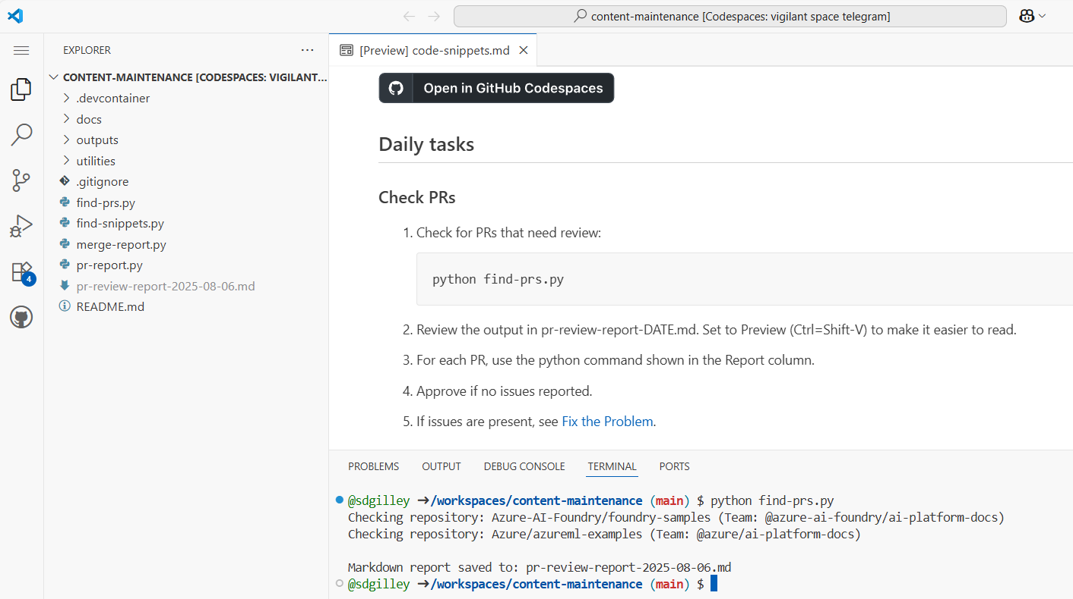
Daily: 1. run find-prs
CODESPACE
Notes:
Daily, we check to see if there are PRs that require review. Since we now have code scattered across multiple Code Repos, we have a script that looks through them all.
The output from the script is a markdown file containing the report.

Slide 12
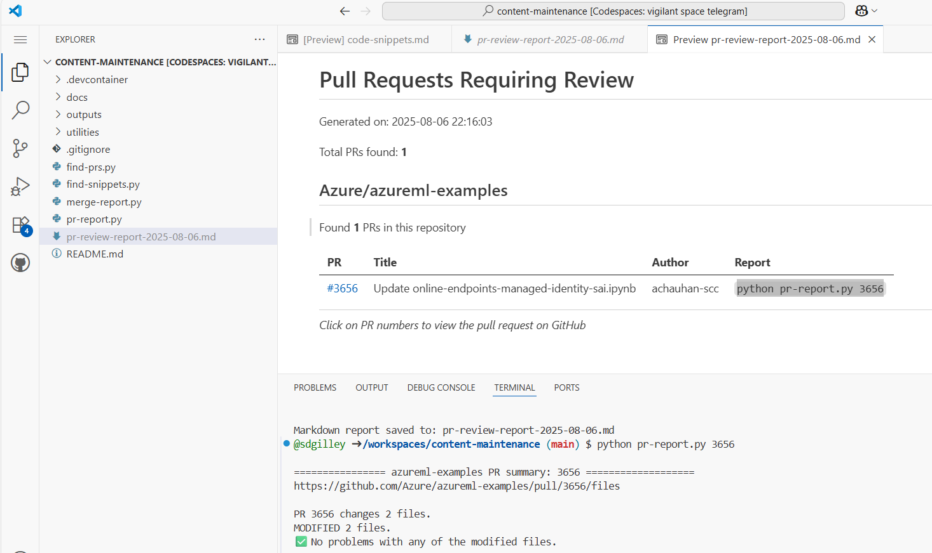
2. run pr-report
CODESPACE
Notes:
Open the markdown file and view the table. There’s a link to each PR to go approve it. But first, run the code to see if there are any problems to worry about. In this case, there were 2 files modified, but no problems with them.

Slide 13
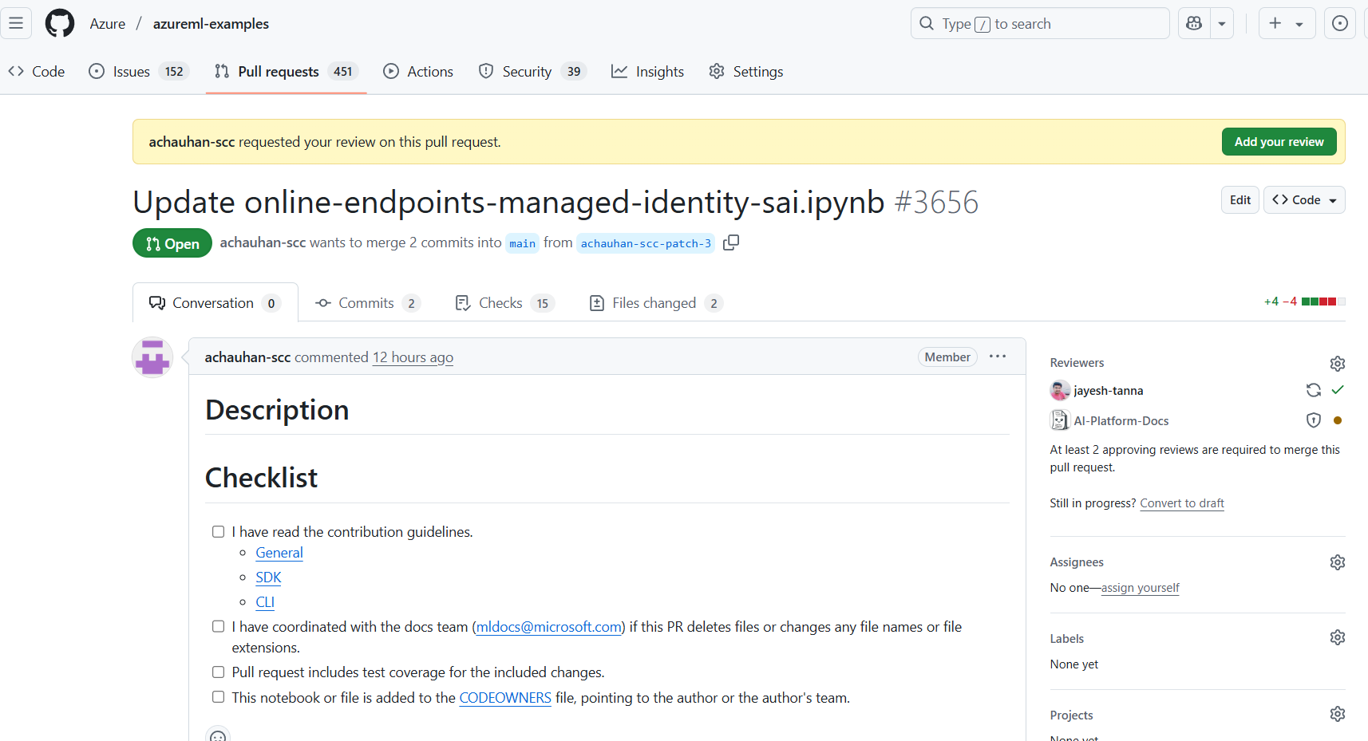
3. approve PR
Notes:
We can go approve this PR. Notice that AI-Platform-Docs is a required reviewer. That’s our GitHub team name, so that anyone in that team can approve.
That’s all there is for daily tasks.
If there had been a problem, there are various ways to fix it – starting with “don’t do that!”
If there’s a reason the file is being deleted, for example, it no longer works, then we need to go fix our docs first. Once the doc stops using the reference, THEN we can approve the PR to remove it from the code repo.
The only time this gets a little trickier is around Build or Ignite. Then we have to remember that there are multiple release branches with our document. We need to allow time for all the release branches to get our change before approving the Code Repo PR.

Slide 14

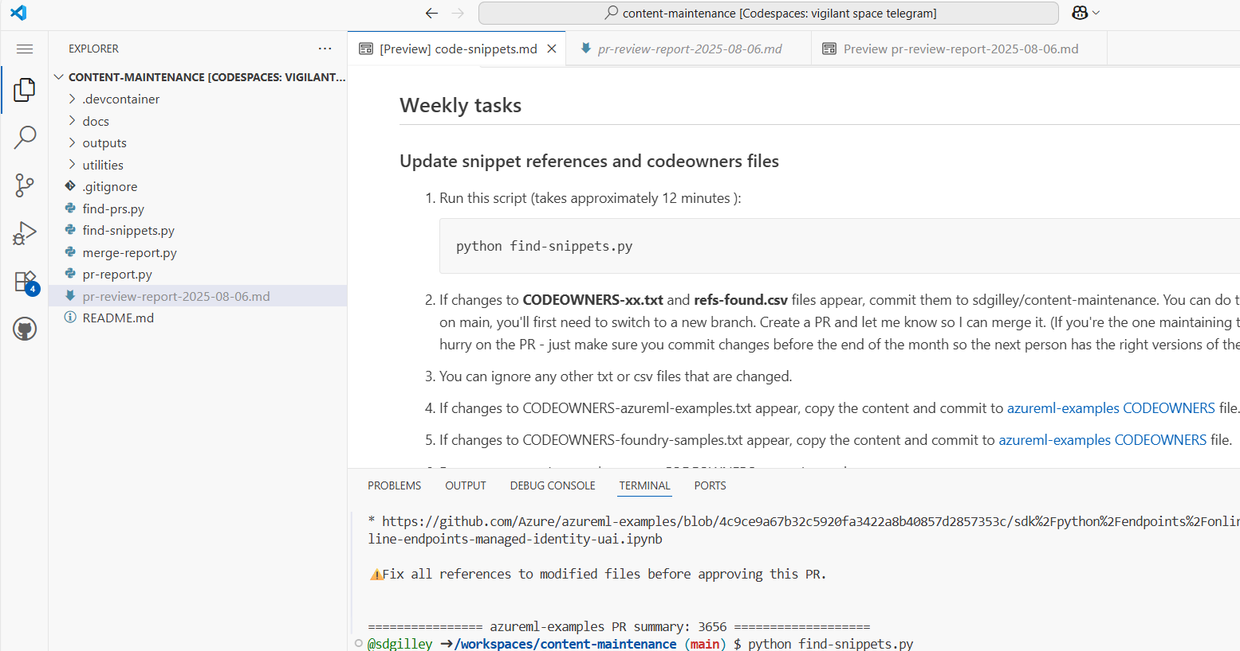
Weekly: 1. find-snippets
Notes:
Now for the weekly tasks. The first one is to search through the docs to find any changes in the files we reference. This process builds CODEOWNERS files for each of the Code Repos we’re monitoring. It takes around 12 minutes to complete.
This process also builds a CSV file that other scripts use to lookup which docs article is referencing which code files.

Slide 15
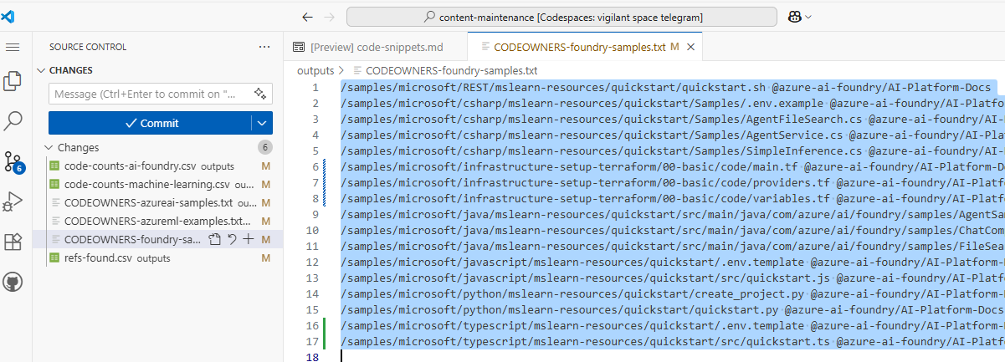
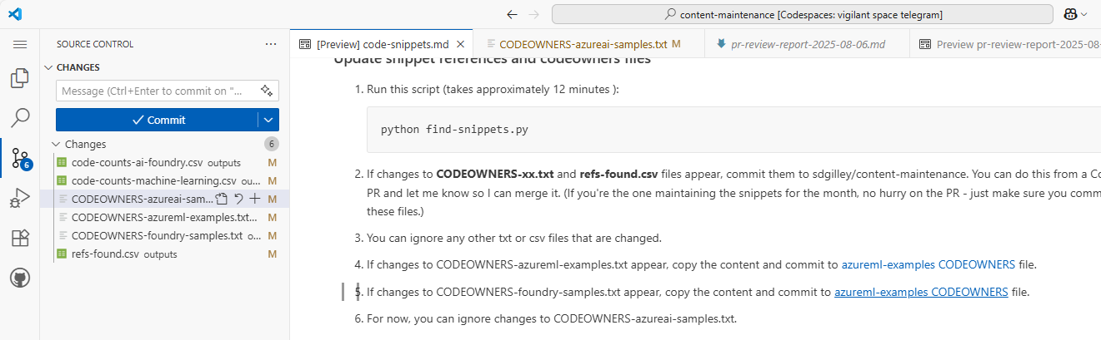
2. Update CODEOWNERS
select all and copy
Notes:
Once the script runs, if there are changes in the CODEOWNERS files, open each one, copy the text, and go to the associated CODEOWNERS file using the link in the instructions.

Slide 16
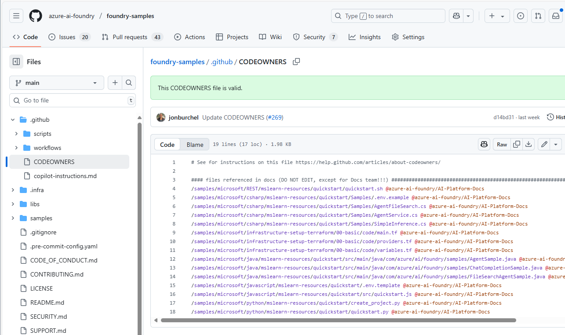
2b. Edit and replace lines
Notes:
Edit the codeowners file and replace the current files with what you just copied. Create a PR to update this file.

Slide 17
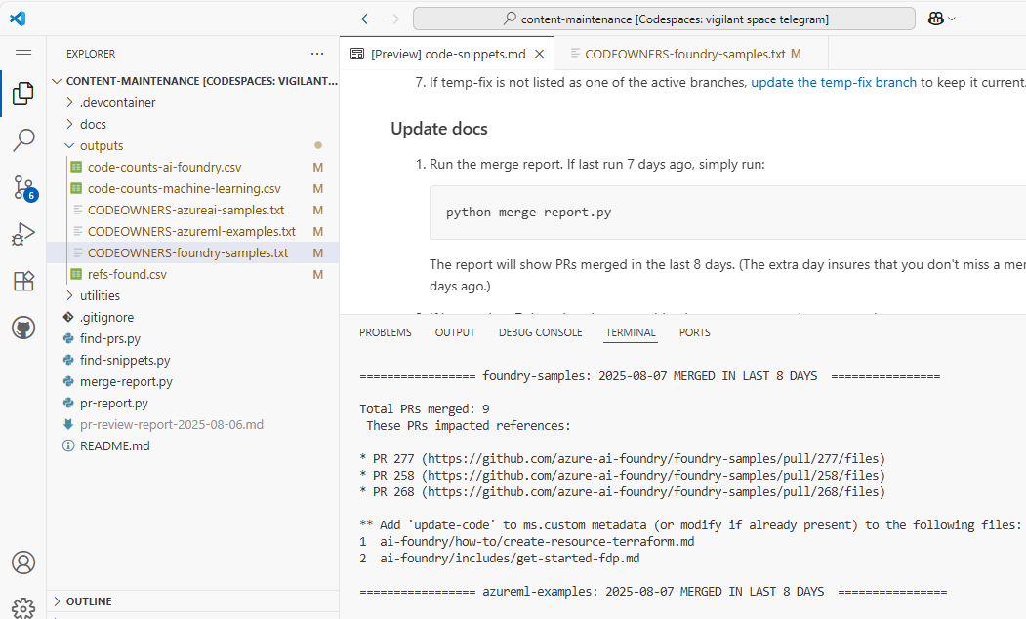
3. Update Docs
Notes:
The next thing to do is find the documents that need to be rebuilt. Run the merge-report to find these. For each repo, it gives a list of the PRs that impacted our docs, along with the names of the files that need to be rebuilt. We add or change the update-code custom metadata to accomplish this.

Slide 18
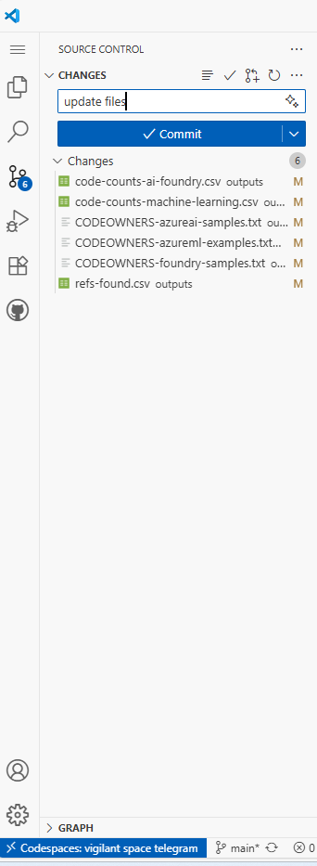
Update maintenance repo
CODESPACE
Notes:
Finally, update the files in the Maintenance Repo itself so that next week, or the next person using the repo, will have the most up to date files.

Slide 19
Maintenance Process
Daily
Monitor pull requests in code repositories
Weekly
Scan documentation for code references
Update CODEOWNERS files
Update docs to rebuild if updated code
Update maintenance repo files
See github.com/sdgilley/content-maintenance
Notes:
That’s the process. This process allows us to prevent build breaks and keep documents up to date with the latest changes. It’s a win-win.

Slide 20

Questions?

Slide 21
Resources
sdgilley/content-maintenance
How to include code in articles on Microsoft Learn - Platform Manual | Microsoft Learn

